Slide 1
Introduction to Neural Networks
FEB 2019
Prepared by - Ishan

Slide 2
1
Why Neural Networks ?
2
What is Neural Network and how it works ?
3
Neural Networks for Handwritten Digits
4
Coding Neural Network in Tensorflow

Slide 3
1
Why Neural Networks ?
2
What is Neural Network and how it works ?
3
Neural Networks for Handwritten Digits
4
Coding Neural Network in Tensorflow

Slide 4
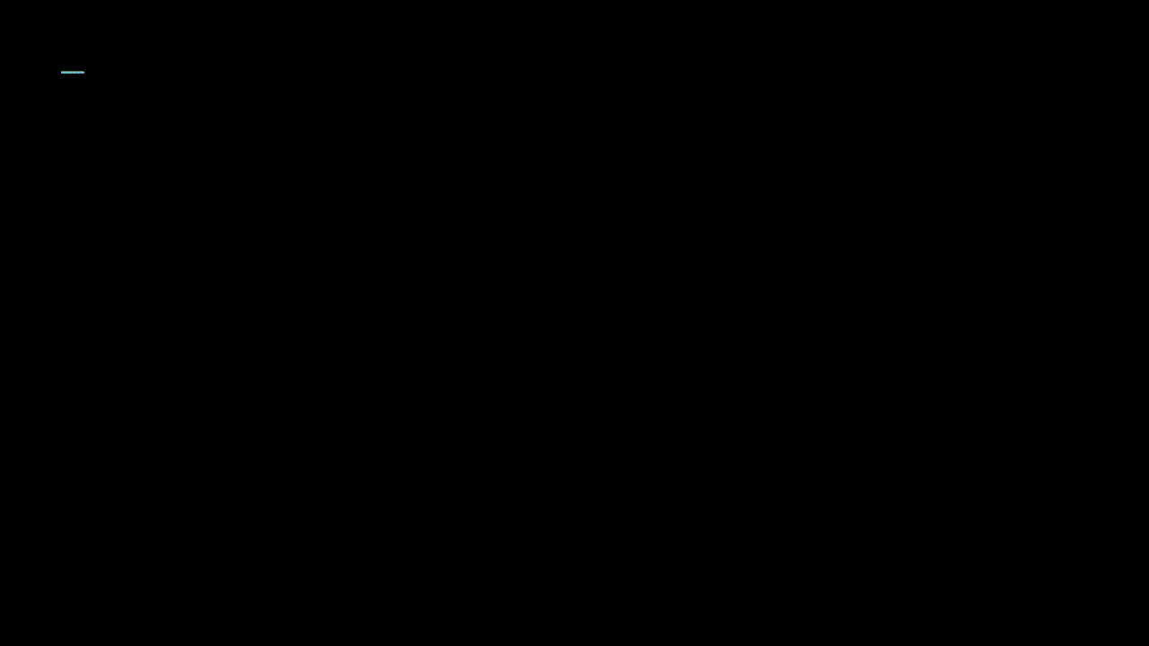
Why neural network ?
Try writing a traditional code that takes the image on the right as an input and gives 3 as an output.
Hard ?

Slide 5
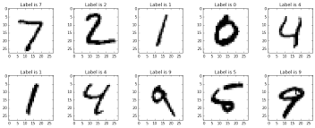
Why neural network ?
Now what about 10 digits ?

Slide 6
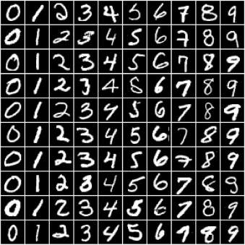
Why neural network ?
Now 100 images with different pixel values ?

Slide 7

Why neural network ?
Now ?
These are just a few variations of 2

Slide 8

Why neural network ?
Solution – Neural Networks

Slide 9
1
Why Neural Networks ?
2
What is Neural Network and how it works ?
3
Neural Networks for Handwritten Digits
4
Coding Neural Network in Tensorflow

Slide 10
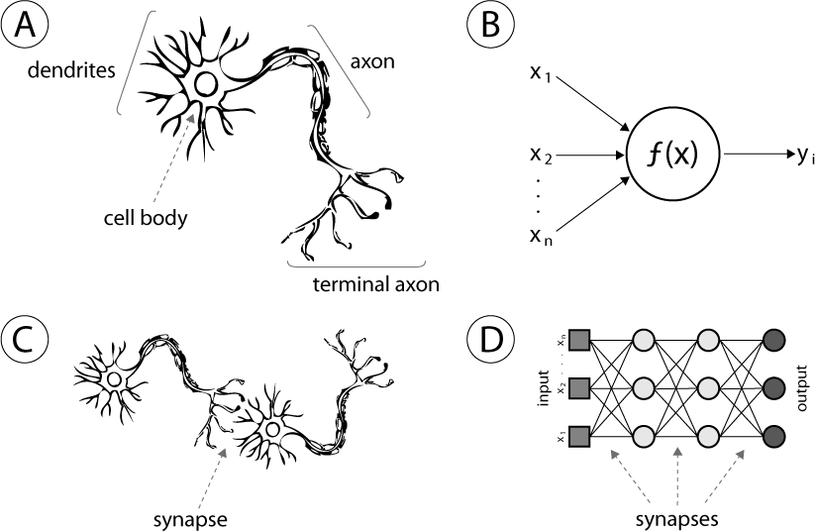
Neural Networks
Human neuron
Artificial neuron or hidden unity;
Biological synapse
ANN synapses

Slide 11
Defining Neural Network
Neural
Network
What are neurons ?
How are the connected?
*We will get to a more traditional definition later

Slide 12
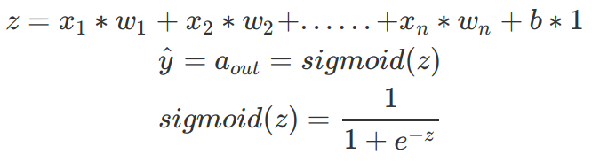
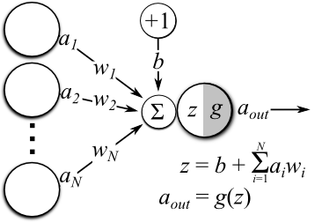
Neural Network
Neuron — It is the basic unit of a neural network. It gets certain number of inputs and a bias value. When a signal value arrives, it gets multiplied by a weight value and bias is added.

Slide 13
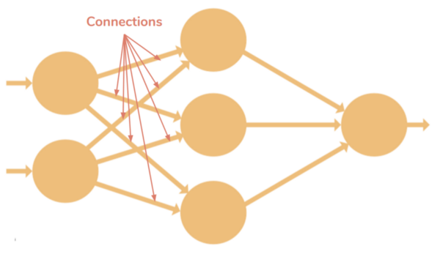
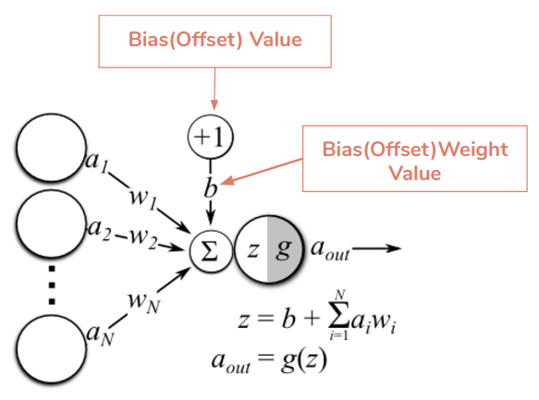
Neural Network
Connections — It connects one neuron in one layer to another neuron in other layer or the same layer. A connection always has a weight value associated with it. Goal of the training is to update this weight value to decrease the loss(error).
Bias(Offset) — It is an extra input to neurons and it is always 1, and has it’s own connection weight. This makes sure that even when all the inputs are none (all 0’s) there’s gonna be an activation in the neuron.

Slide 14
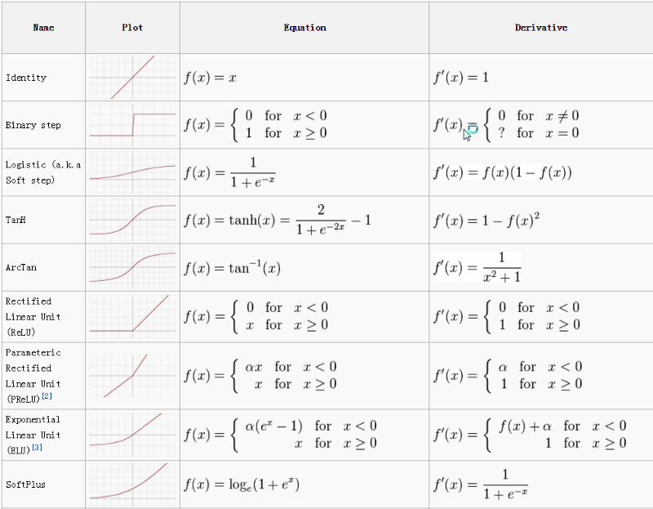
Neural Network
Activation Function(Transfer Function) — Activation functions are used to introduce non-linearity to neural networks. It squashes the values in a smaller range viz. a Sigmoid activation function squashes values between a range 0 to 1. There are many activation functions used in deep learning industry and ReLU, SeLU and TanH are preferred over sigmoid activation function. In this article I have explained the different activation functions available.

Slide 15
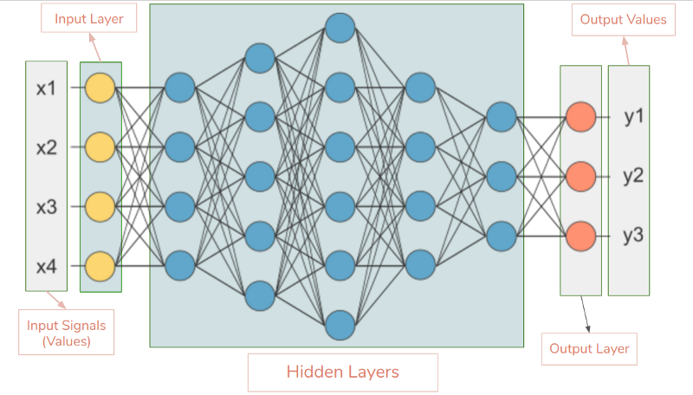
Neural Network
Input Layer — This is the first layer in the neural network. It takes input values and passes them on to the next layer. It doesn’t apply any operations on the values & has no weights and biases values associated.
Hidden Layers — Hidden layers have neurons which apply different transformations to the input data. Last hidden layer passes on values to the output layer. All the neurons in a hidden layer are connected to each and every neuron in the next layer, hence we have a fully connected hidden layers.
Output Layer — This layer is the last layer in the network & receives input from the last hidden layer. With this layer we can get desired number of values and in a desired range.
Input Shape — It is the shape of the input matrix we pass to the input layer.
Weights— A weight represent the strength of the connection between units. Weights near zero means changing this input will not change the output. Negative weights mean increasing this input will decrease the output. A weight decides how much influence the input will have on the output.

Slide 16
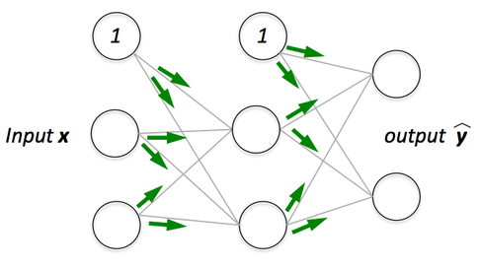
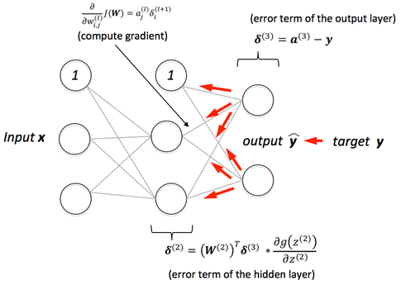
Neural Network
Forward Propagation — Forward propagation is a process of feeding input values to the neural network and getting an output which we call predicted value. Sometimes we refer forward propagation as inference. When we feed the input values to the neural network’s first layer, it goes without any operations. Second layer takes values from first layer and applies multiplication, addition and activation operations and passes this value to the next layer. Same process repeats for subsequent layers and finally we get an output value from the last layer.
Back-Propagation :
Backpropagation is a method used in artificial neural networks to calculate a gradient that is needed in the calculation of the weights to be used in the network.
Backpropagation is shorthand for "the backward propagation of errors," since an error is computed at the output and distributed backwards throughout the network’s layers.

Slide 17

Neural Network
Pay attention to the white board

Slide 18
What is a Neuron

Slide 19
What is a Neuron Network

Slide 20

Input layer and activation

Slide 21
Output layer and Hidden Layer

Slide 22
Complete Picture

Slide 23
What are the Layers Doing ?

Slide 24
What are the Layers Doing ?

Slide 25
Weights

Slide 26
Activation function and Bias

Slide 27
Updated definition of neurons

Slide 28
Training Process

Slide 29
1
Why Neural Networks ?
2
What is Neural Network and how it works ?
3
Neural Networks for Handwritten Digits
4
Coding Neural Network in Tensorflow

Slide 30
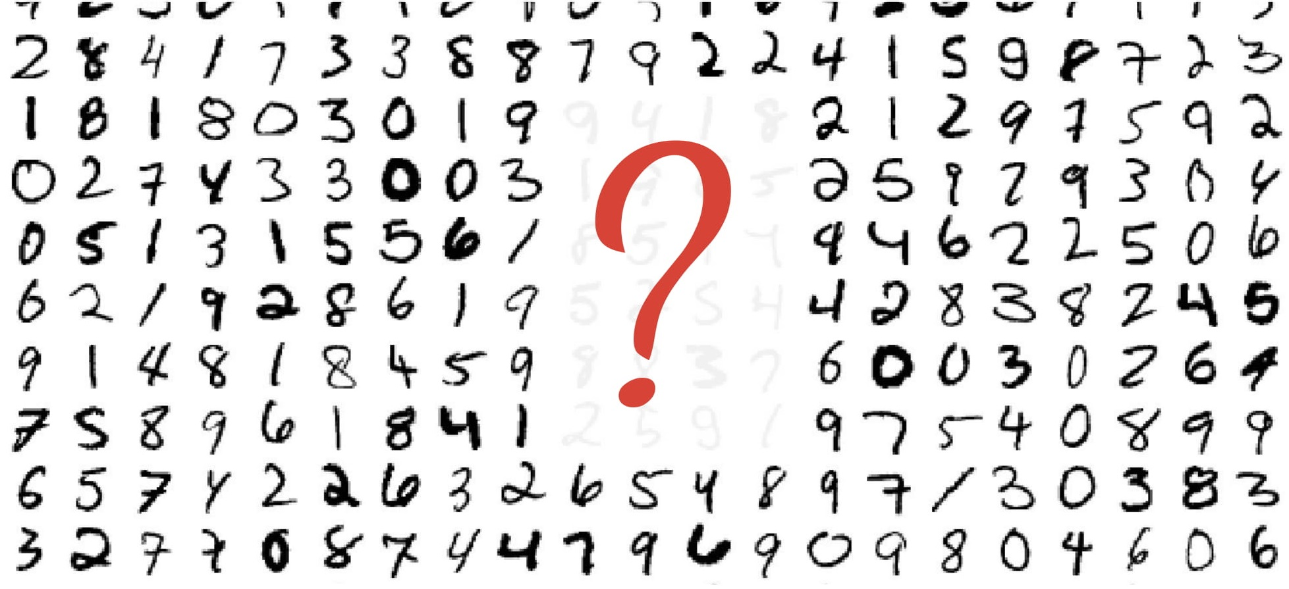
Handwritten digits classification

Slide 31
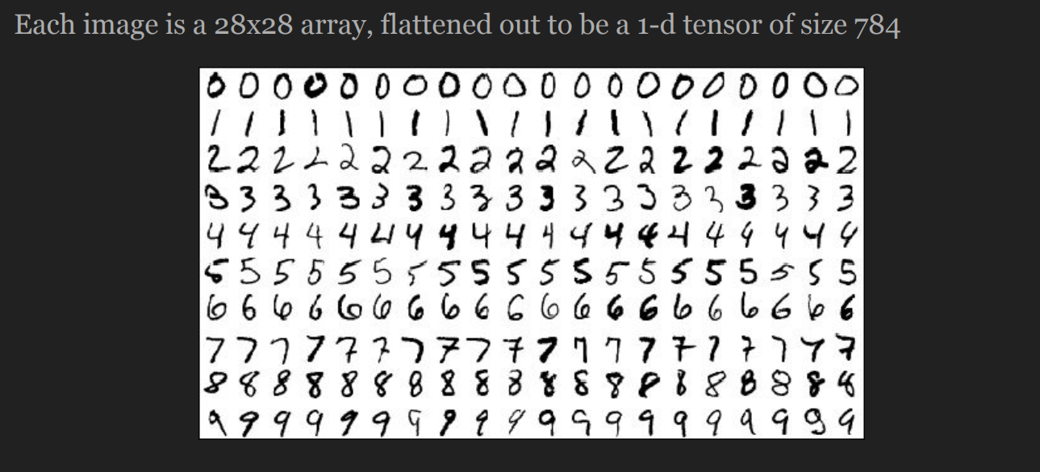
MNIST dataset

Slide 32
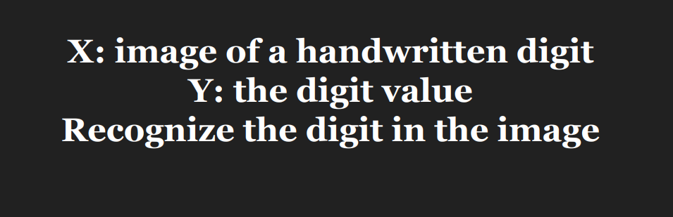
Goal ?

Slide 33
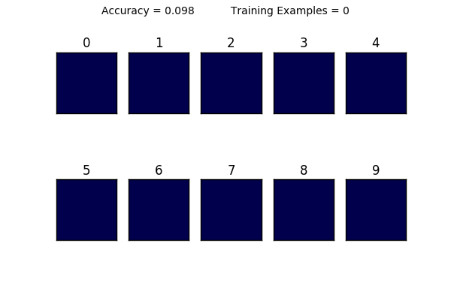
Expected training process

Slide 34

Coding Time !
C:\Users\... > jupyter notebook

